Slide 1
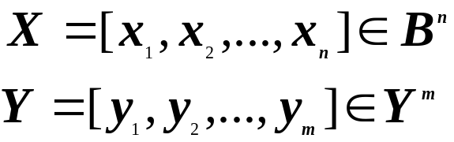


Basic Definitions
Let B = {0,1} Y = {0,1,2}
A logic function f in n inputs x_{1,} x_{2, ...}x_{n} and
m outputs y₁,y₂, ...y_{m} is a function
f : B^{n}
Y^{m}
is the input
is the output
For each component f_{i}, i = 1,2, ...,m, define
ON_SET:the set of input values x such that f_{i}(x) =1
OFF_SET:the set of input values x such that f_{i}(x) = 0
DC_SET:the set of input values x such that f_{i}(x) = 2
Completely specified function : DC_SET = φ, for f_{i}
φ
Incompletely specified function : DC_SET ,for some f_{i}
m=1 => a single output function
m>1 => a multiple output function

Slide 2
Representations
1. Truth Table
full adder
X Y Cin Sum Cout
0 0 0 0 0
0 0 1 1 0
0 1 0 1 0
0 1 1 0 1
1 0 0 1 0
1 0 1 0 1
1 1 0 0 1
1 1 1 1 1
a multiple output function
Sum : on-set = {(0 0 1), (0 1 0), (1 0 0),
(1 1 1)}
off-set= {(0 0 0), (0 1 1), (1 0 1),
(1 1 0)}
a completely specified function

Slide 3
Representations
2. Geometrical representation
  1 variable
0
1
  2 variables
00
01
10
11
3 variables
011
111
001
101
010
010
110
000
100
sum : on-set ={(0 0 1),(0 1 0),(1 0 0),(1 1 1)}
off-set ={(0 1 1),(1 0 1),(1 1 0),(0 0 0)}

Slide 4
Representations
3. Algebraic representations
Canonical sum of product
C_{out} = x’yC_{in} + xy’C_{in} + xyC_{in}’ + xyC_{in}
Reduced sum of product
C_{out} = yC_{in} + xC_{in} + xy
= yC_{in} + xC_{in} + xyC_{in}’
Multi-level representation
C_{out} = C_{in} (x + y) + xy

Slide 5
Representations
4. Reduced Ordered Binary Decision
Diagram (ROBDD)
Decision graph:
f = x₁x₂ + x₃
Terminal node:
attribute
value (v) = 0
value (v) = 1
Non-terminal node:
index (v) = i
two children
low (v)
high (v)
Evaluate an input vector
x₁
0
1
x₂
x₂
0
1
0
1
x₃
x₃
x₃
x₃
0
10
0
1
10
1
0
1
0
1 0
1
1
1

Slide 6
ROBDD
A BDD graph which has a vertex v as root
corresponds to the function F_{v} :
(1) If v is a terminal node:
a) if value (v) is 1, then F_{v} = 1
b) if value (v) is 0, then F_{v} = 0
(2) If F is a nonterminal node(with index(v) = i)
F_{v}(x_{i} , ...x_{n}) = x_{i}’ F_{low(v)} (x_{i+1} , ...x_{n}) +
x_{i} F_{high(v)} (x_{i+1} , ...x_{n})

Slide 7
ROBDD
Reduced BDD :
No distinct vertices v and v’ such that sub- graphs rooted by v and v’ are isomorphism.
No vertex v with low (v) = high (v)

Slide 8
F=x₁x₂+x₁x₃+x₁x₂x₃
x₁
0
1
x₂
x₂
0
1
0
1
x₃
x₃
x₃
x₃
0
1
0
1
0
1
0
1
0
1
0
1
0
1
1
1
x₁
0
1
x₂
x₂
0
1
0
1
x₃
1
x₃
1
0
x₃
0
x₃
0
1
1
0
x₁
1
0
0
1
x₂
x₂
1
0
0
1
x₁
x₃
0
1
1
0
0
1
x₂
0
x₃
1
0
1
0
1

Slide 9
ROBDD
Ordered BDD: if x < y, then all nodes representing x precede all nodes representing y
Given an ordering of variables, reduced OBDD is canonical

Slide 10
Example
The size of OBDD depends on the ordering of
variables
ex : x₁x₂ + x₃x₄
x₁ < x₂ < x₃ < x₄
x₁
1
0
x₂
0
1
x₃
1
0
x₄
0
1
0
1

Slide 11
Example
For a good ordering, the size of an OBDD
remains reasonably small
Multiplier is an exception
x₁
0
1
x₃
x₃
1
0
1
0
x₂
x₂
0
1
0
1
x₄
0
1
0
1
x₁ < x₃ < x₂ < x₄

Slide 12



Operations on ROBDD
Apply f₁ <op> f₂
(f₁, f₂ must have the same ordering of variables,
then operations can be operated on f₁, f₂ )
f₁ f₂ = (x₁’g₁ + x₁g₂)(x₁’g₃ + x₁g₄)
= x₁’g₁g₃ + x₁g₂g₄
= x₁’(g₁g₃) + x₁(g₂g₄)
f₁
f₂
f₁ f₂
x₁
x₁
x₁
0
1
0
1
0
1
g₁
g₂
g₃
g₄
g₁g₃
g₂g₄
f₁ + f₂
f₁ f₂
etc.

Slide 13
ROBDD
complement : f
1
f1
f2 : f1’ + f1f2 (implication)
time complexity
Reduced O(
G
log
G
)
Apply O(
G₁
G₂
)

Slide 14
Property of ROBDD
(1) Commonly encountered functions have
reasonable representations.(except
multiplier)
(2) Complementation will not blow up the
representation.
(3) Canonical form so that equivalence,
satisfiability checking can be done easily.
(4) Multi-level representation

Slide 15



Characteristic Function
Let E be a set and A E
The characteristic function A is the function
X_{A} : E -> { 0,1 }
X_{A}(x) = 1 if x A
X_{A}(x) = 0 if x A
Ex:
E = { 1,2,3,4 }
A = { 1,2 }
X_{A}(1) = 1
X_{A}(3) = 0
A
E

Slide 16


Characteristic Function
Given a Boolean function
f : B^{n} -> B^{m} ,
the mapping relation denoted as
is defined as
The characteristic function of a function f is defined for (x,y) s.t. X_{f}(x,y) = 1 iff (x,y) F

Slide 17
Characteristic Function
Ex: y = f( x₁,x₂ ) = x₁ + x₂
x₁ x₂ y
0 0 0
0 1 1
1 0 1
1 1 1
Fy(x₁,x₂,y) =
x₁ x₂ y F
0 0 0 1
0 0 1 0
0 1 0 0
0 1 1 1
1 0 0 0
1 0 1 1
1 1 0 0
1 1 1 1

Slide 18
Operation on Logic Function
Complement
Intersection
Union
Difference
XOR
F is a tautology
Cofactor
Boolean difference
Consensus operator
Smoothing operator

Slide 19


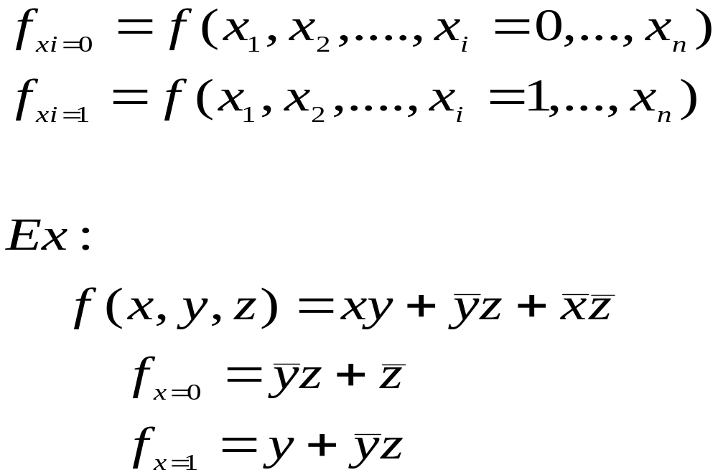
Cofactor
Cofactor operation ( restriction )
cofactor of f with respect to x_{i}=0
cofactor of f with respect to x_{i}=1

Slide 20
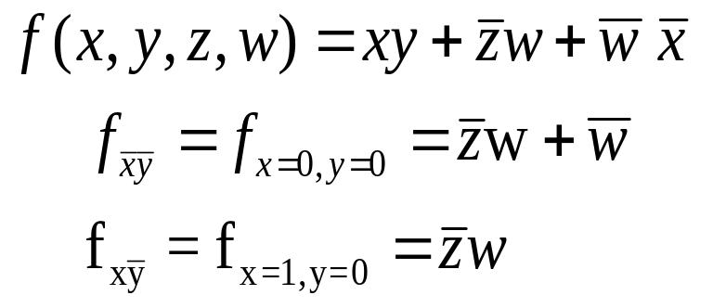
Cofator
Cofactor with respect to any cube
Ex:

Slide 21
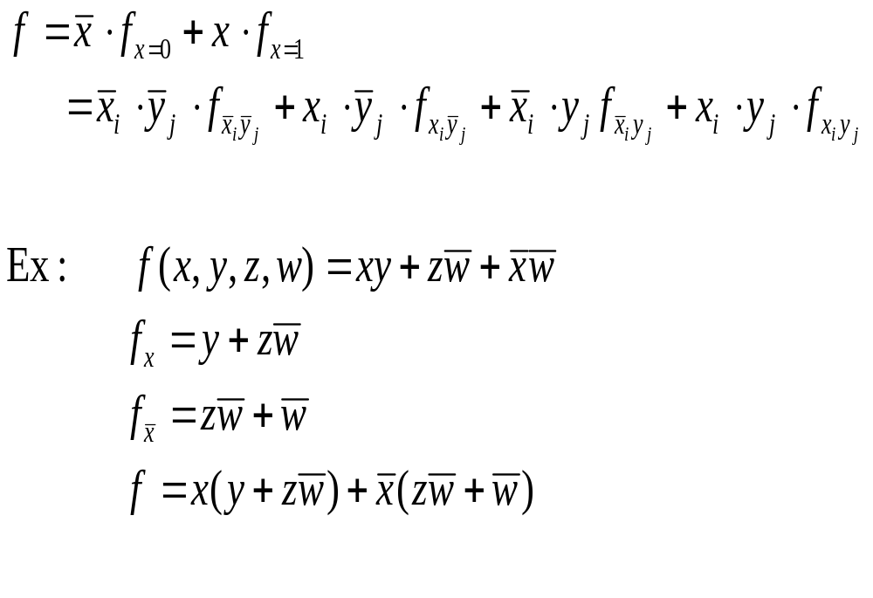
Shannon Expansion

Slide 22

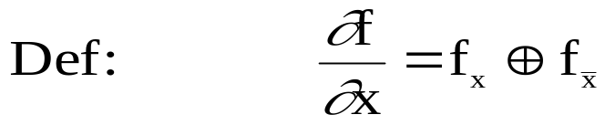
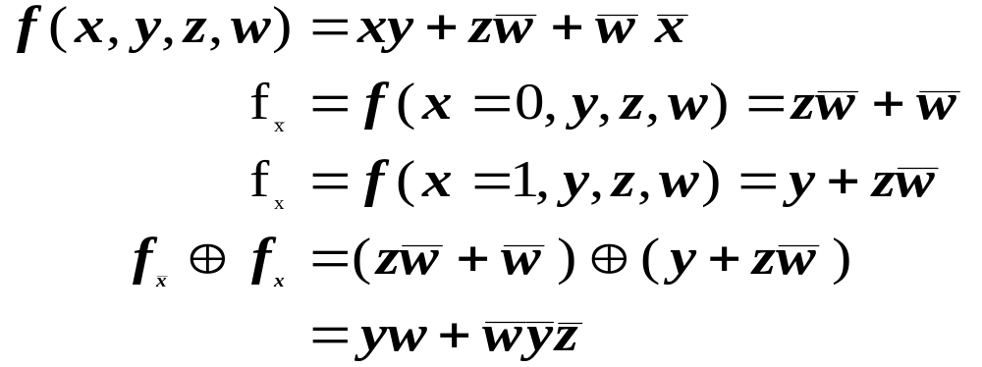
Boolean Difference
is called Boolean difference of f with respect to x
f is sensitive to the value of x when
Ex:

Slide 23


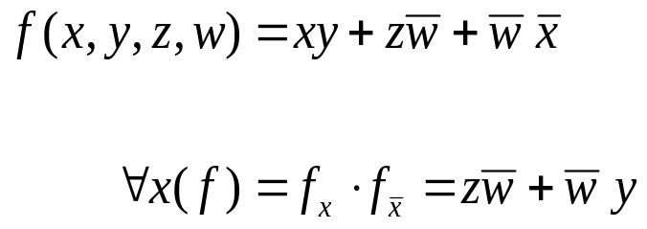
Consensus Operator
evaluate f to be true for x=1 and x=0
Ex:

Slide 24


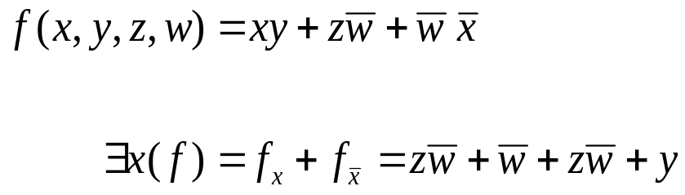
Smoothing Operator
evaluate f to be true for x=1 or x=0
Ex:

